Slide 1



Ali Murtadho
Python (machine learning)

Slide 2




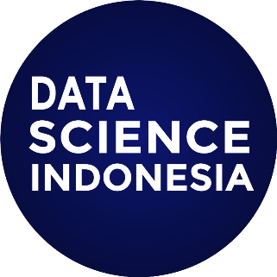
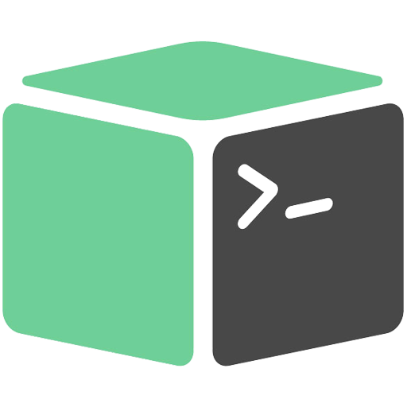
Informatic Engineering Student at UNTAG from 2016 - 2020
Programmer PT maestro Digital Utama
Front End Developer, PT Codemi Global
Backend Dev, Trustmedis
Active research at DSI
Mentorship at Kotakode

Slide 3
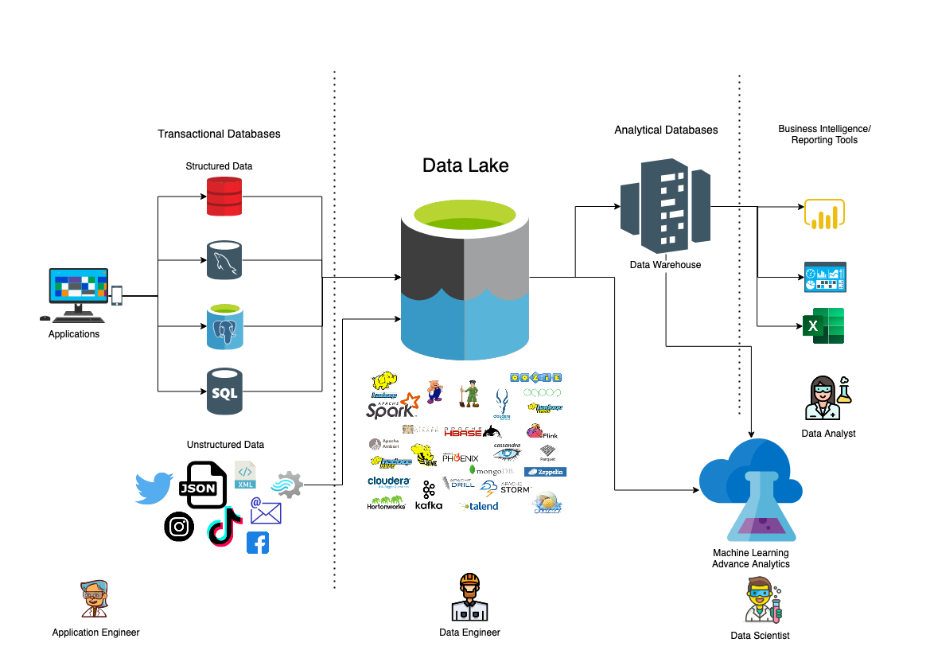

Slide 4
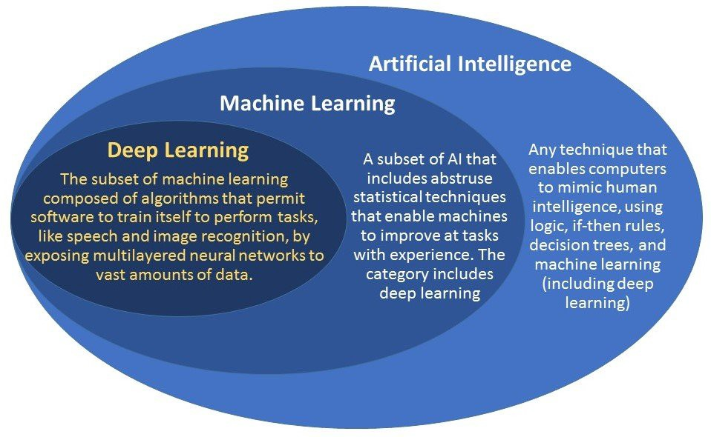

Slide 5
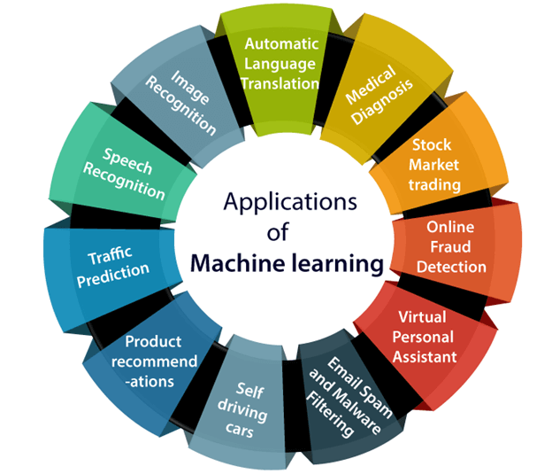

Slide 6
Why Python ?
Free & Easy
Dynamic (OOP, Functional)
Multi OS (Windows, Linux, MacOS)
Multi purpose (Web App, Desktop App, DevOps, Mobile App, Gaming, Data science, Robotics, Big Data Engineering etc)

Slide 7
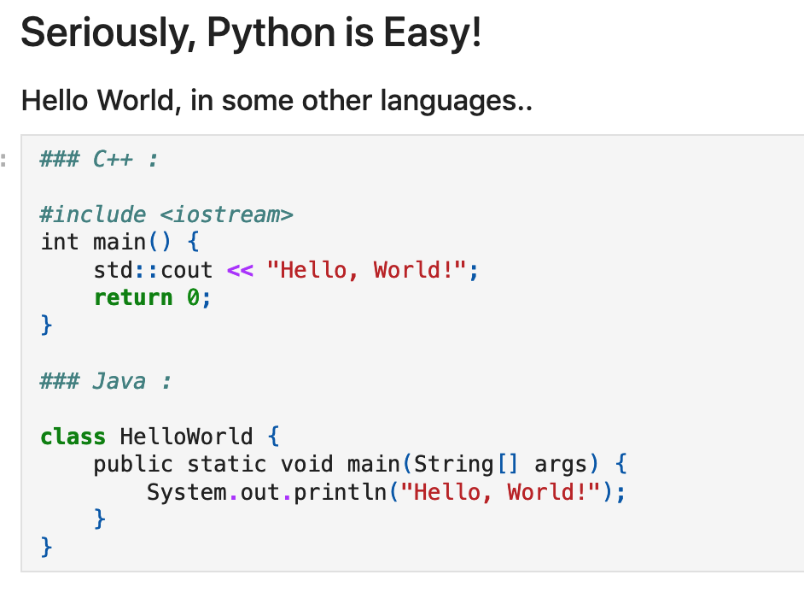


Slide 8
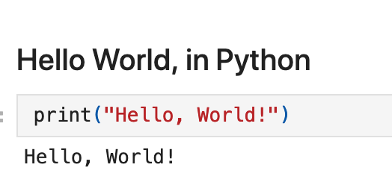


Slide 9


Slide 10
Thank you

Slide 11
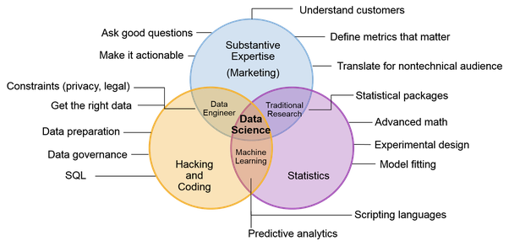
What is Data Science?

Slide 12
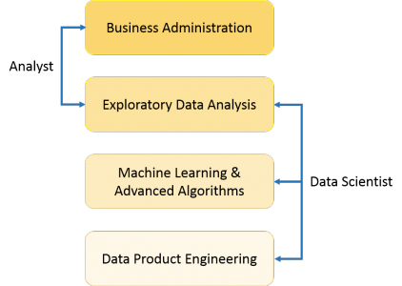
What is Data Science?

Slide 13
What is Data Science?
Data science is an integration of multiple disciplines, including machine learning, software engineering, data engineering, and many more. Both of these two fields try to extract information.

Slide 14
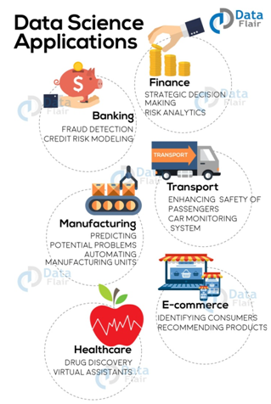
examples of Data Science applications.

Slide 15
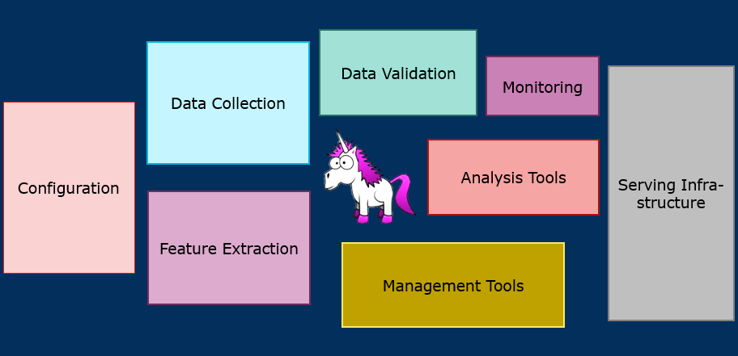
Data Science Steps

Slide 16
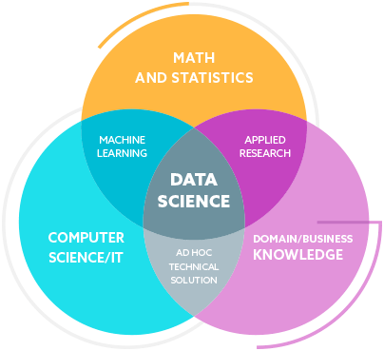
Data Science Steps

Slide 17
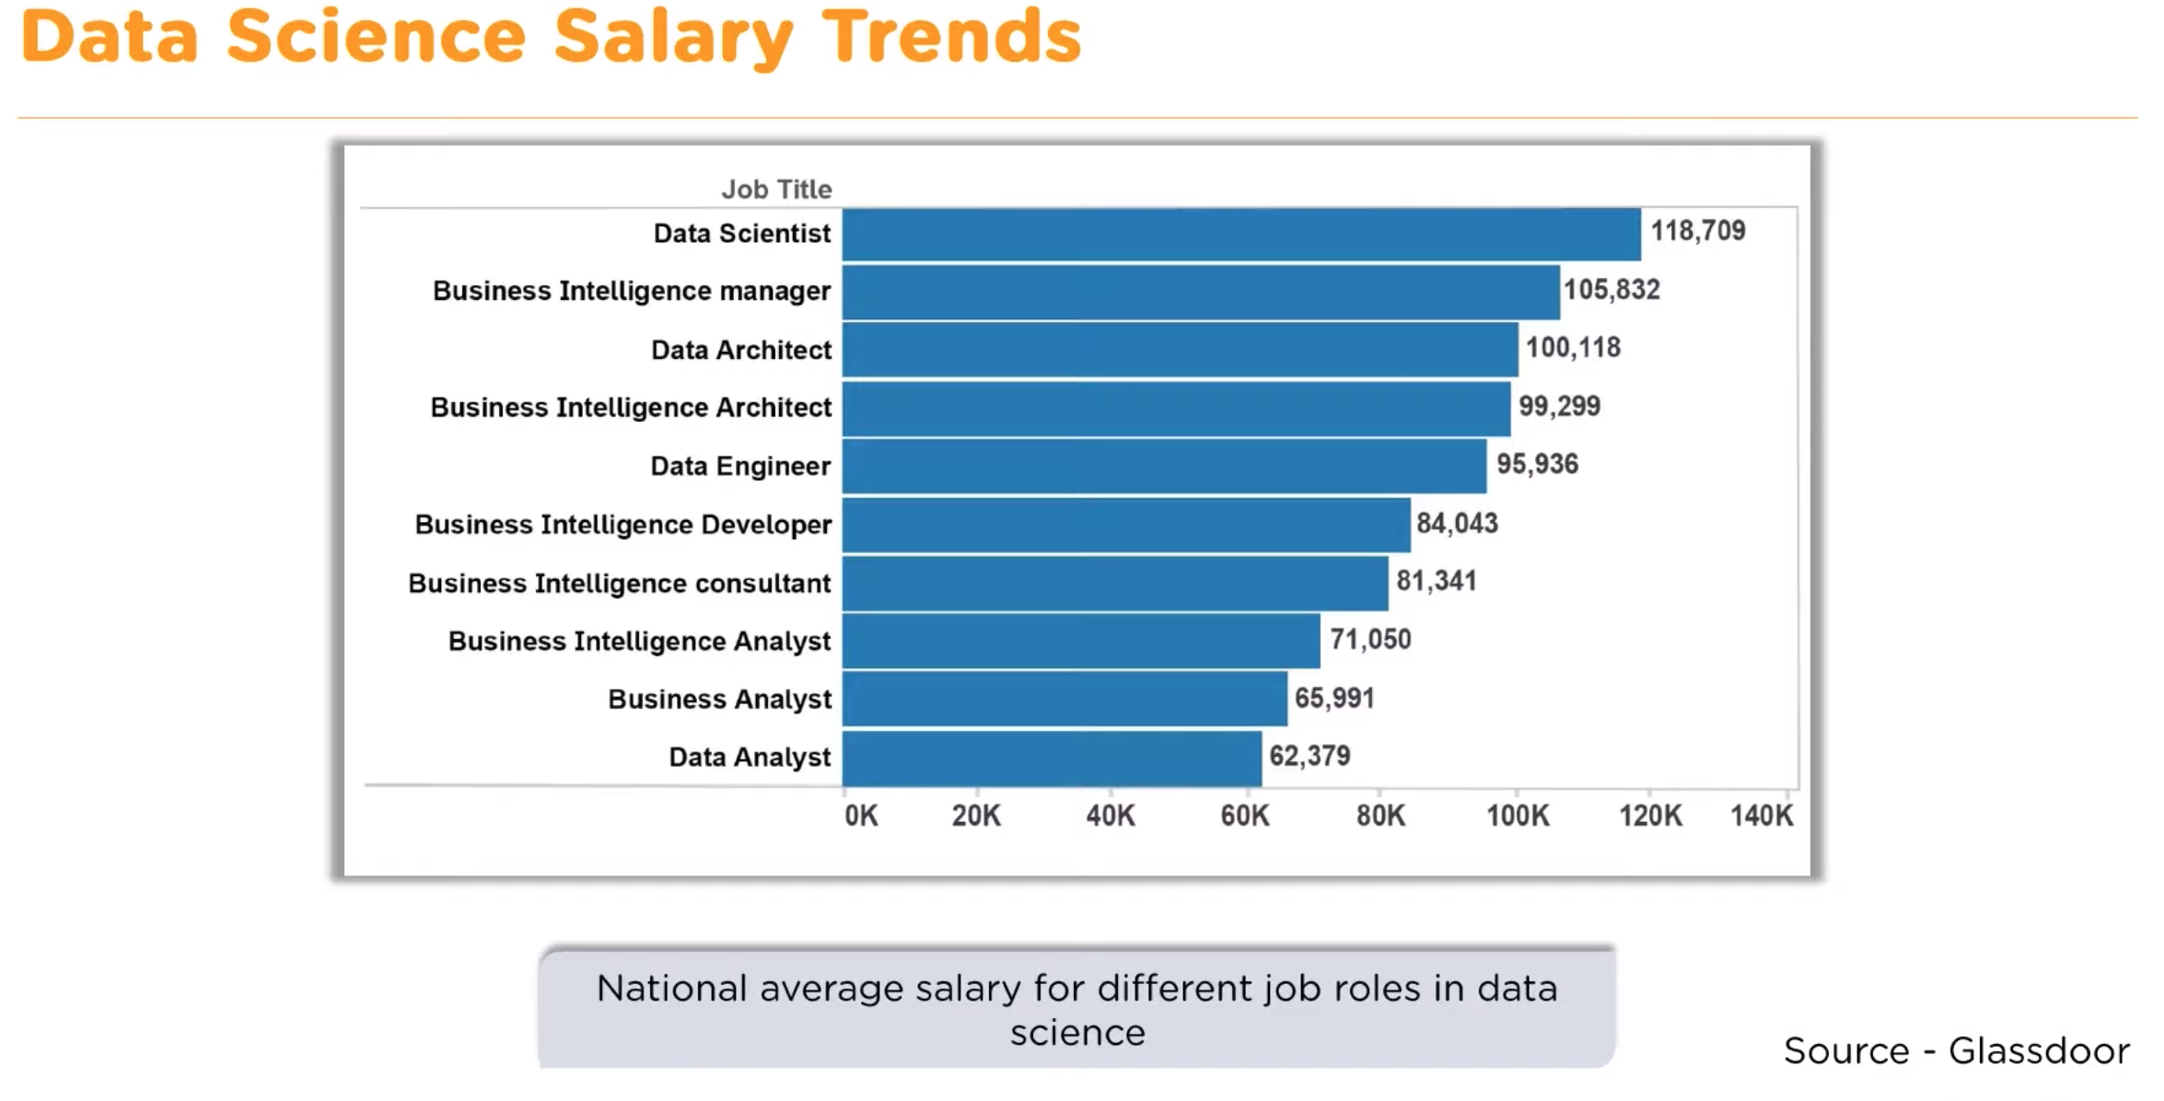

Slide 18


Slide 19
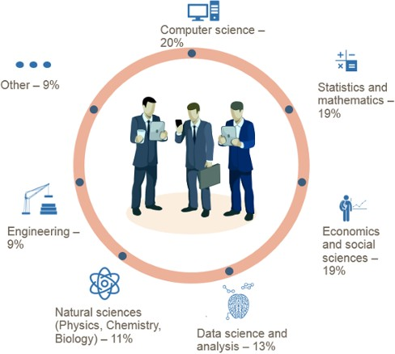
Who Are Data Scientists?
https://www.datascience.com/blog/data-scientist-skills

Slide 20
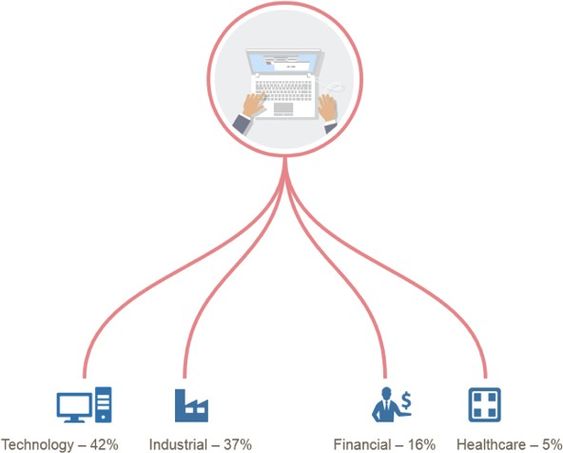
Who Are Data Scientists?
https://www.datascience.com/blog/data-scientist-skills

Slide 21
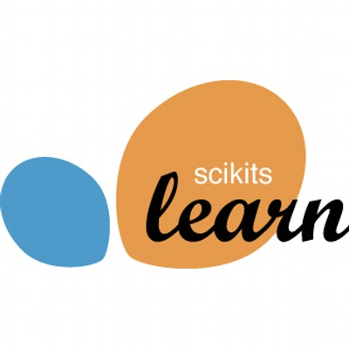

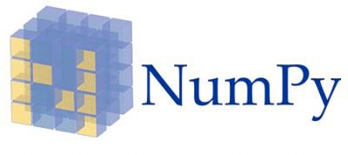
Learning Data Science With Python - Libraries
A free software machine learning library that features various classification, regression and clustering algorithms including support vector machines, random forests, gradient boosting, and k-means and is designed to interoperate with the Python numerical and scientific libraries NumPy and SciPy.
Pandas is a software library written for the Python programming language for data manipulation and analysis. In particular, it offers data structures and operations for manipulating numerical tables and time series.
NumPy is a library for the Python programming language, adding support for large, multi- dimensional arrays and matrices, along with a large collection of high-level mathematical functions to operate on these arrays.

Slide 22
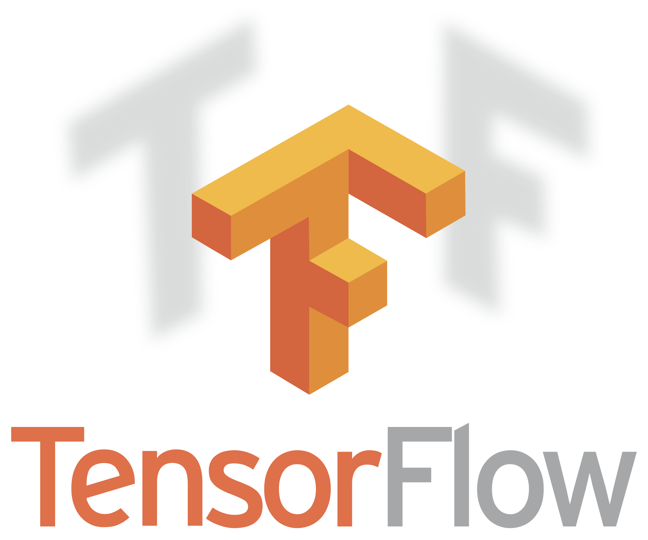
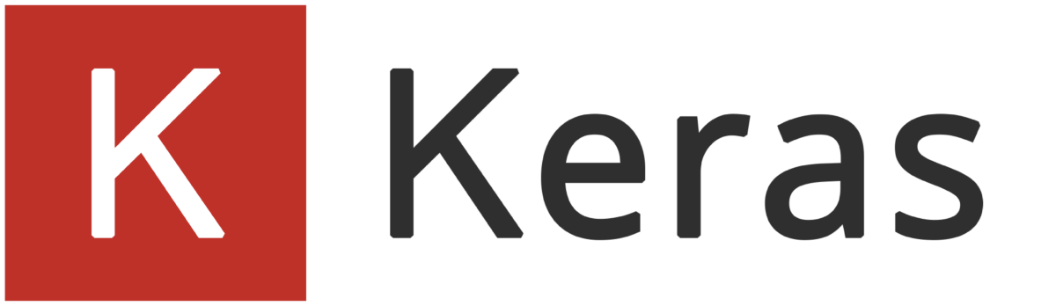
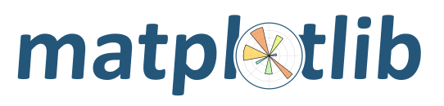
Learning Data Science With Python - Libraries
A plotting library for the Python programming language and its numerical mathematics extension NumPy
TensorFlow is an open-source software library for dataflow programming across a range of tasks. It is a symbolic math library, and is also used for machine learning applications such as neural networks.
Keras is an open source neural network library written in Python. It is capable of running on top of TensorFlow, Microsoft Cognitive Toolkit, Theano, or MXNet. It was developed with a focus on enabling fast experimentation

Slide 23

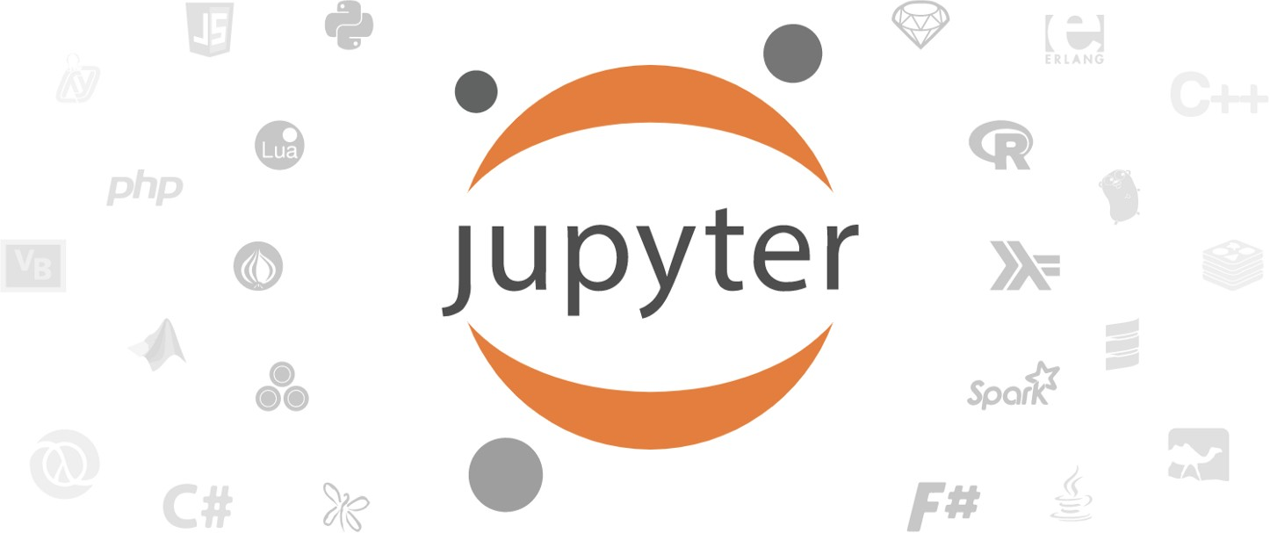
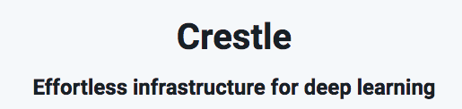
Learning Data Science With Python - Tools
Open-source web application that allows you to create and share documents that contain live code, equations, visualizations and narrative text
http://jupyter.org/
Similar to Jupyter Notebook, but with the added benefit of “google doc” type sharing and collaboration https://colab.research.google.com
Crestle is your GPU-enabled Jupyter environment in the cloud. https://www.crestle.com/

Slide 24


Slide 25
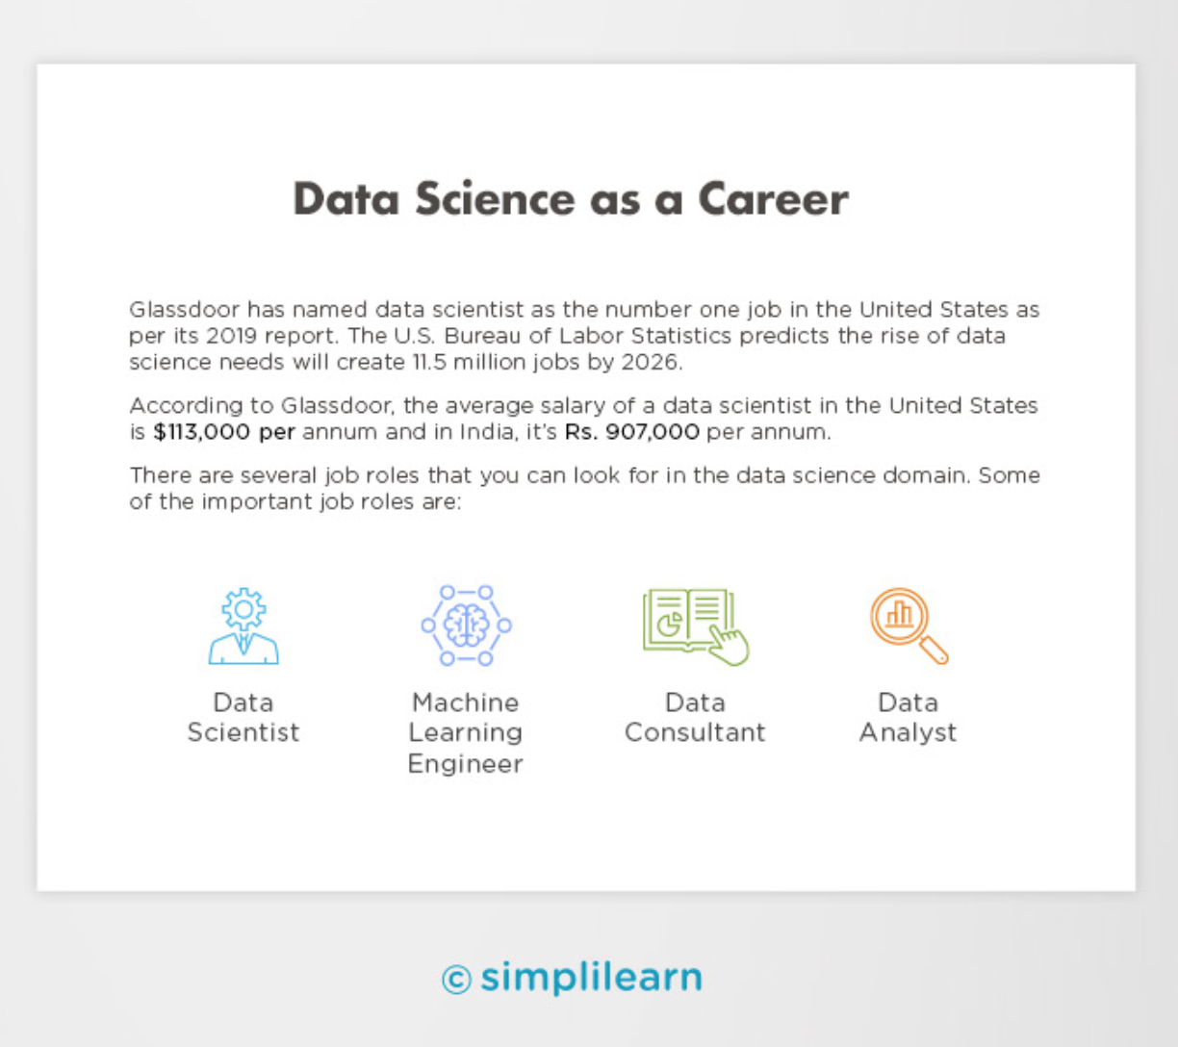

Slide 26
Questions?

